Slide 1
Why Python for Data Science?
DATA SCIENCE COURSE
Lecturer SO Vengleab · April 2026
Notes:
Est 2 min. Hook: today we answer one question — do you really need to code?

Slide 2
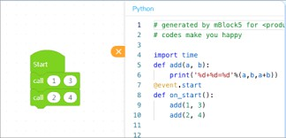
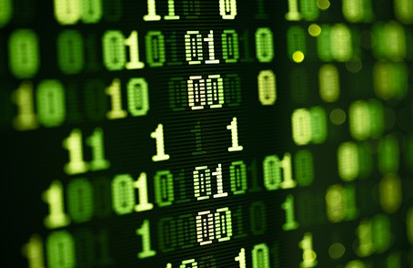
Introduction to Python
PROGRAMMING
Python is a Programming language.
You write source code — human-readable instructions.
It is translated into computer code the machine executes.
Together they become software.
Notes:
Source slide 23.

Slide 3
Is coding a must for Data Science?
THE BIG QUESTION
Let’s settle this before we write a single line.
Notes:
Ask the room first. Take a show of hands.

Slide 4
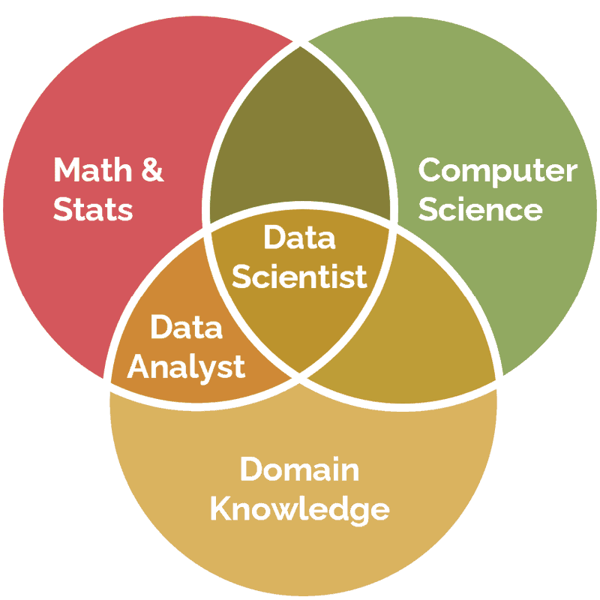
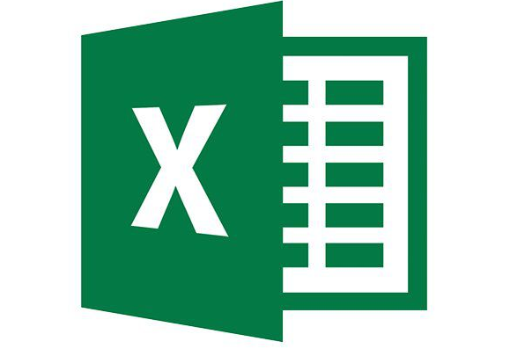
The Answer is NO!
THE BIG QUESTION
You can do data science without writing code.
No-code tools cover the basics: Excel, Google Sheets, Power BI, Tableau, KNIME.
Drag-and-drop workflows can collect, clean, and chart data.
Venn Diagram of Data Science Field
Insight: No-code gets you started fast — the question is what happens when the data grows and the task repeats.
Notes:
Pause on this slide — it surprises people. Then pivot to the tasks.

Slide 5
What Data Scientists Do
DAY-TO-DAY WORK
Data Collection
Preparation & Cleansing
EDA
Model Building
Communicate
Pull data from files, databases, APIs, and the web.
Fix missing values, duplicates, and messy formats.
Explore, summarize, and visualize to find patterns.
Train machine learning models — if the problem needs one.
Share findings and collaborate with the team.
Notes:
Every task on this slide can be done with OR without code — next slide compares.

Slide 6
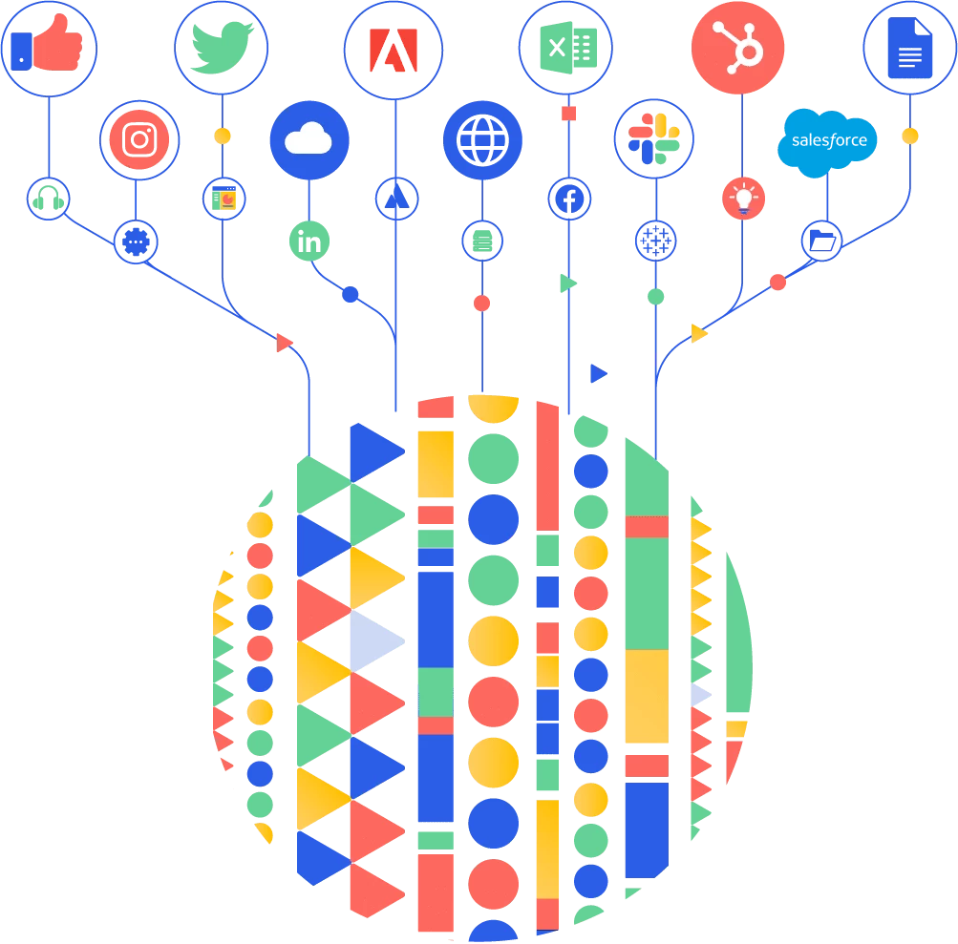
Data Collection

Slide 7
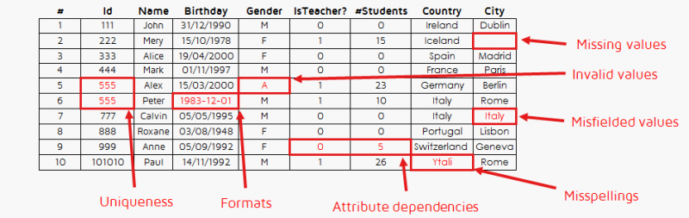
Data Preparation and Cleansing

Slide 8
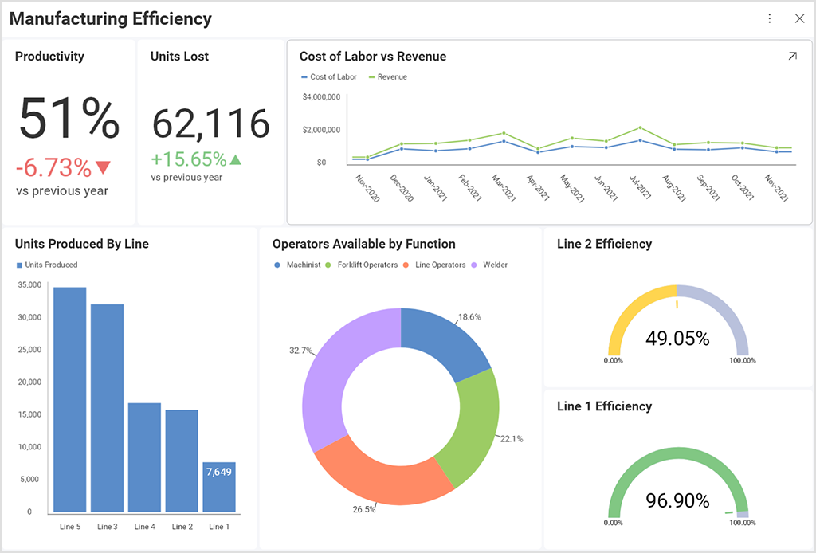
Exploratory Data Analysis (EDA)

Slide 9
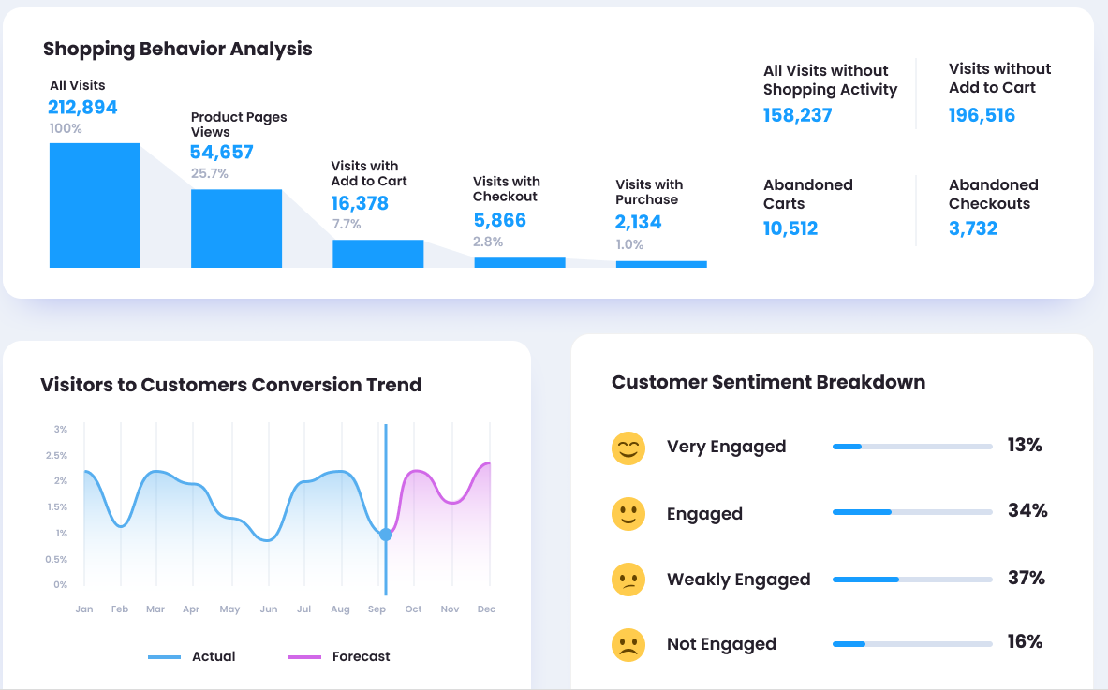
Exploratory Data Analysis (EDA)

Slide 10
Without Coding vs With Python
THE TRADE-OFF
Without coding
With coding — especially Python
Quick start — click, drag, drop
Limited to what the tool offers
Hard to automate repeated work
Struggles with large or messy data
Workflows are hard to share and reproduce
One script handles collection to communication
Automate anything, schedule it, rerun it
Scales to millions of rows
Full control over cleaning, EDA, and models
Code is shareable, versioned, reproducible
Notes:
This is the 'why it matters' beat — no-code hits a ceiling; Python removes it.

Slide 11
Why Python?
GETTING STARTED
A one-slide definition — then your first program.
Notes:
Transition into the language itself.

Slide 12


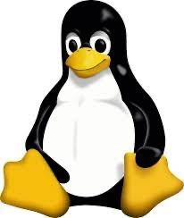
Why Python?
PROGRAMMING
Simple, powerful, everywhere.
Open-source and free, running on Windows, Mac, and Linux.
General purpose — suitable for analysis of financial data and far beyond.
High-level: human-readable code that beginners can pick up fast.
Notes:
Source slides 24–25 merged; OS logos kept.

Slide 13
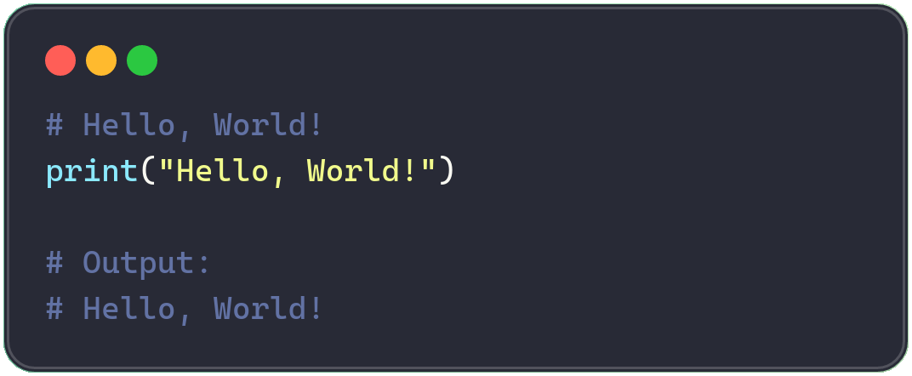
What is Python
GETTING STARTED
Three things to know
High-level language — Python reads almost like plain English, easy to learn and write.
Created in 1991 — designed by Guido van Rossum; now one of the world’s most popular languages.
Used everywhere — web dev, data science, AI, automation, scripting.
Your first Python program →
Insight: Simple. Powerful. Elegant — one line of Python is already a complete program.
Notes:
Run print('Hello, World!') live if possible.

Slide 14
Reference
REFERENCE
https://www.python.org/about/
https://docs.python.org/3/tutorial/
https://pandas.pydata.org/
https://scikit-learn.org/
Notes:
Close quietly — exercises live in the separate exercise deck.

